Slide 1




Intention and
Representing Beliefs, Perspectives & Counterfactuals: A Puzzle
Motor Representation
in Joint Action
s.butterfill@warwick.ac.uk
Motor Representation and Shared Intention s.butterfill@warwick.ac.uk
s.butterfill@warwick.ac.uk
Notes:
Which events are joint actions? Nearly all philosophers and quite a few psychologists have assumed that this question can be fully answered by appeal to a special kind of intention, often called shared intention. According to them, for an event to be a joint action is for it to stand in an appropriate relation to a shared intention.

Slide 2

first time processing a perspective difference
first time representing a false belief
first time reasoning counterfactually
Notes:
I’m going to start from a premise which is rightly controversial: reciprocal agent-neutral motor representation enables joint action

Slide 3
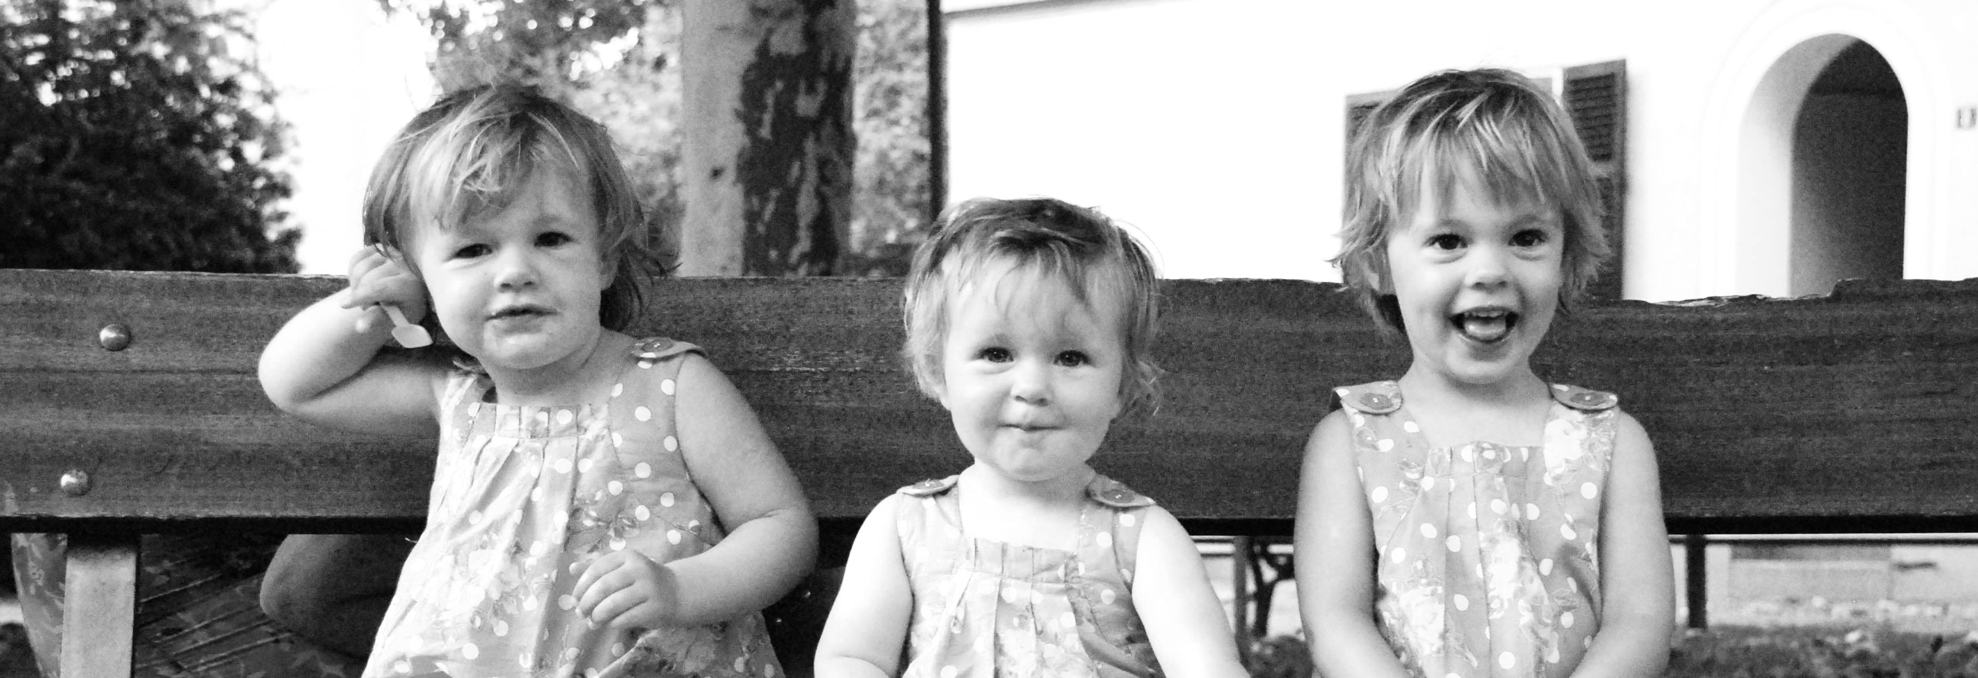
1. Infants can represent false beliefs from around their first birthday or earlier.
2. Being able to represent false beliefs involves being able to (i) process perspective differences or (ii) reason counterfactually (or both).
3. Infants cannot (i) process perspective differences nor (ii) engage in counterfactual reasoning until they are at least one year old.
Notes:
I’m going to start from a premise which is rightly controversial: reciprocal agent-neutral motor representation enables joint action

Slide 4
1. Infants can represent false beliefs from around their first birthday or earlier.
2. Being able to represent false beliefs involves being able to (i) process perspective differences or (ii) reason counterfactually (or both).
3. Infants cannot (i) process perspective differences nor (ii) engage in counterfactual reasoning until they are at least one year old.
Notes:
I’m going to start from a premise which is rightly controversial: reciprocal agent-neutral motor representation enables joint action

Slide 5
1. Infants can represent false beliefs from around their first birthday or earlier.
2. Being able to represent false beliefs involves being able to (i) process perspective differences or (ii) reason counterfactually (or both).
3. Infants cannot (i) process perspective differences nor (ii) engage in counterfactual reasoning until they are at least one year old.
Notes:
I’m going to start from a premise which is rightly controversial: reciprocal agent-neutral motor representation enables joint action

Slide 6
1. Infants can represent false beliefs from around their first birthday or earlier.
2. Being able to represent false beliefs involves being able to (i) process perspective differences or (ii) reason counterfactually (or both).
3. Infants cannot (i) process perspective differences nor (ii) engage in counterfactual reasoning until they are well over one year old.
Notes:
I’m going to start from a premise which is rightly controversial: reciprocal agent-neutral motor representation enables joint action

Slide 7
Children tend to pass them some time after their third birthday.
Abilities to pass these tasks has a protracted developmental course stretching over months if not years.
Success on these tasks is correlated with developments in executive function and language
Success on these tasks is facilitated by explicit training and environmental factors such as siblings
Abilities to succeed on these tasks typically emerge from extensive participation in social interactions
A-tasks
Notes:
I’m going to start from a premise which is rightly controversial: reciprocal agent-neutral motor representation enables joint action

Slide 8
1’. Infants can represent false beliefs implicitly from around their first birthday or earlier.
2’. Being able to represent false beliefs explicitly involves being able to (i) process perspective differences or (ii) reason counterfactually (or both).
3’. Infants cannot (i) process perspective differences nor (ii) engage in counterfactual reasoning until they are at least one year old.
Notes:
I’m going to start from a premise which is rightly controversial: reciprocal agent-neutral motor representation enables joint action

Slide 9
1’. Infants can represent false beliefs using a comparatively simple measure from around their first birthday or earlier.
2’. Being able to represent false beliefs using a comparatively sophisticated measure involves being able to (i) process perspective differences or (ii) reason counterfactually (or both).
3’. Infants cannot (i) process perspective differences nor (ii) engage in counterfactual reasoning until they are at least one year old.
Notes:
I’m going to start from a premise which is rightly controversial: reciprocal agent-neutral motor representation enables joint action

Slide 10
1’. Infants can represent false beliefs using a comparatively simple measure and in a modular process from around their first birthday or earlier.
2’. Being able to represent false beliefs using a comparatively sophisticated measure and in a non-modular process involves being able to (i) process perspective differences or (ii) reason counterfactually (or both).
3’. Infants cannot (i) process perspective differences nor (ii) engage in counterfactual reasoning until they are at least one year old.
Notes:
I’m going to start from a premise which is rightly controversial: reciprocal agent-neutral motor representation enables joint action

Slide 11
1’’’ Infants can represent false beliefs using a comparatively simple measure and in a modular process from around their first birthday or earlier.
2’’’ Being able to represent false beliefs using a comparatively sophisticated measure and in a non-modular process involves being able to (i) process perspective differences or (ii) reason counterfactually (or both).
3’’’ Infants cannot (i) process perspective differences nor (ii) engage in counterfactual reasoning until they are well over one year old.
Notes:
I’m going to start from a premise which is rightly controversial: reciprocal agent-neutral motor representation enables joint action

Slide 12
1’’’ Infants can represent false beliefs using a comparatively simple measure and in a modular process from around their first birthday or earlier.
2’’’ Being able to represent false beliefs using a comparatively sophisticated measure and in a non-modular process involves being able to (i) process perspective differences or (ii) reason counterfactually (or both).
3’’’ Infants cannot (i) process perspective differences nor (ii) engage in counterfactual reasoning until they are well over one year old.
Notes:
I’m going to start from a premise which is rightly controversial: reciprocal agent-neutral motor representation enables joint action

